Slide 1






Voting Web Application Using Django Framework
Student Details
Name: DHANAPRABU.V
NM Id: 922221104011
College Name : Theni Kammavar Sangam College of Technology

Slide 2
Voting Web Application Using Django Framework
Disclaimer
The content is curated from online/offline resources and used for educational purpose only

Slide 3
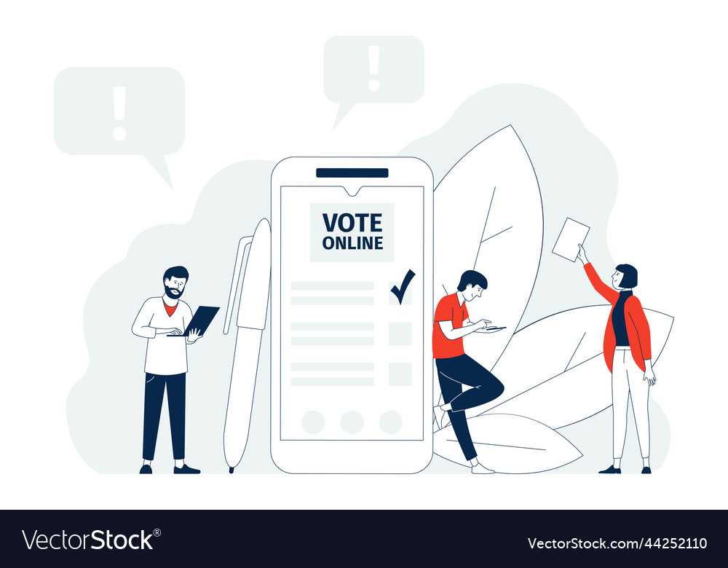
Course Outline
Voting Web Application Using Django Framework
Abstract
Problem Statement
Aims&Objective
Result
Conclusion

Slide 4


Voting Web Application Using Django Framework
Abstract
The goal of the proposed project is to create a secure and easy-to-use online voting web application based on the Django framework. Traditional methods of voting are cumbersome and time consuming in today’s digital world. By using web technologies, we will be able to create a platform that allows for efficient and accessible voting while maintaining the integrity and safety of the voting process.

Slide 5


Voting Web Application Using Django Framework
Problem Statement
The objective of this project is to create a secure, user-friendly, and scalable web application that facilitates various types of voting processes, such as elections, surveys, and polls.
The application should provide an intuitive interface for both voters and administrators while ensuring the integrity and confidentiality of the voting process.

Slide 6

Voting Web Application Using Django Framework
Aim and Objective
Aim: Our goal is to create a secure and easy-to-use Django-based web application that will allow registered users to vote on various topics. The app will have features for creating, viewing, and voting on different topics, as well as real-time voting results. It will also have an administration panel that will manage voting topics and accounts. The app will focus on security measures to prevent unauthorised access and keep the voting process secure. Users will be able to interact and engage with the app through features such as commenting and sharing, providing an interactive voting experience.

Slide 7
Voting Web Application Using Django Framework
Objectives
User Authentication and Management:
Implement user registration, login, and logout functionalities.
Ensure password encryption and secure authentication mechanisms.
Allow users to update their profiles and reset passwords if forgotten.
Voting System Functionality:
Enable users to view a list of available voting topics and options.
Implement the ability for users to cast their votes for different options.
Ensure that each user can only vote once per topic.
Provide real-time updates of voting results to users.
Administration Panel:
Create an administrative interface for managing voting topics and options.
Allow administrators to add, edit, and delete voting topics and options.
Implement user management features for administrators to manage user accounts and permissions.
Security Measures:
Implement measures to prevent fraudulent voting, such as CAPTCHA or IP restrictions.
Ensure that user authentication and data transmission are secure using HTTPS.
Protect against common security vulnerabilities like SQL injection and cross-site scripting (XSS) attacks.

Slide 8
Voting Web Application Using Django Framework
User Interaction and Engagement:
Enable users to comment on voting topics and engage in discussions.
Implement features like upvoting or downvoting comments to encourage participation.
Provide social sharing options to allow users to share voting topics on social media platforms.
Accessibility and Responsiveness:
Design the application to be accessible to users with disabilities, following WCAG guidelines.
Ensure that the user interface is responsive and compatible with various devices and screen sizes.
Testing and Quality Assurance:
Write unit tests to ensure the functionality of different components, including user authentication and voting features.
Conduct integration tests to verify the interaction between different modules and components.
Perform usability testing to ensure that the application meets the needs of its target users.
Documentation and Support:
Provide comprehensive documentation for users and administrators on how to use the application.
Include a FAQ section to address common questions and issues.
Offer user support through email or a dedicated support system to assist users with any problems they encounter.

Slide 9
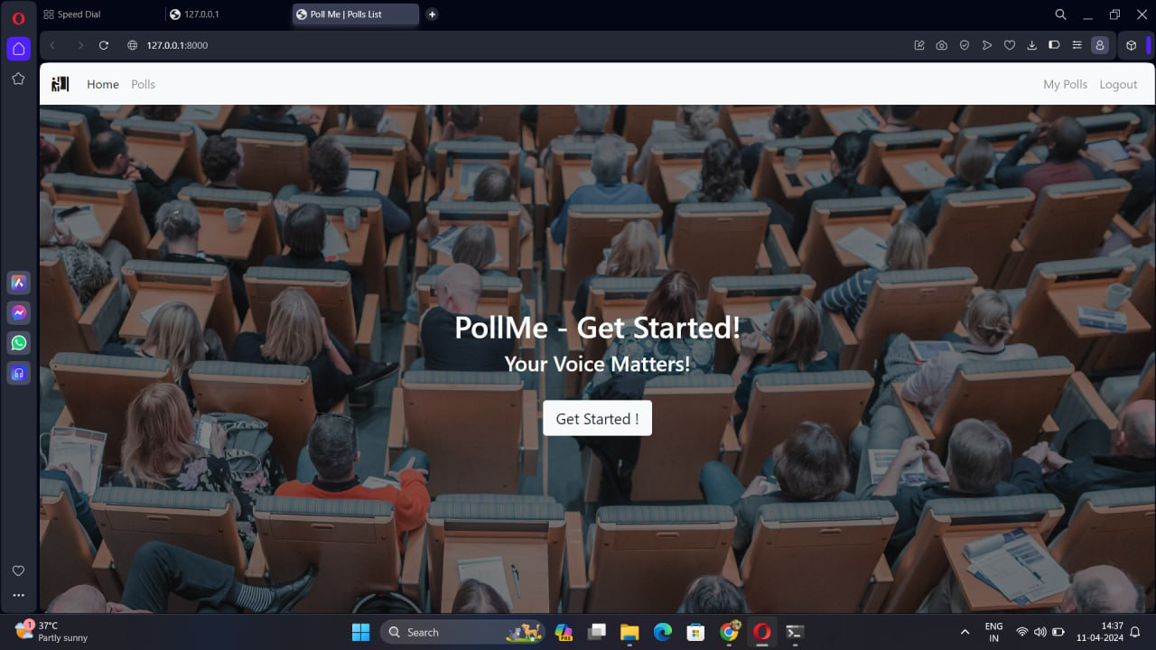
Voting Web Application Using Django Framework
Result
Notes:
9

Slide 10
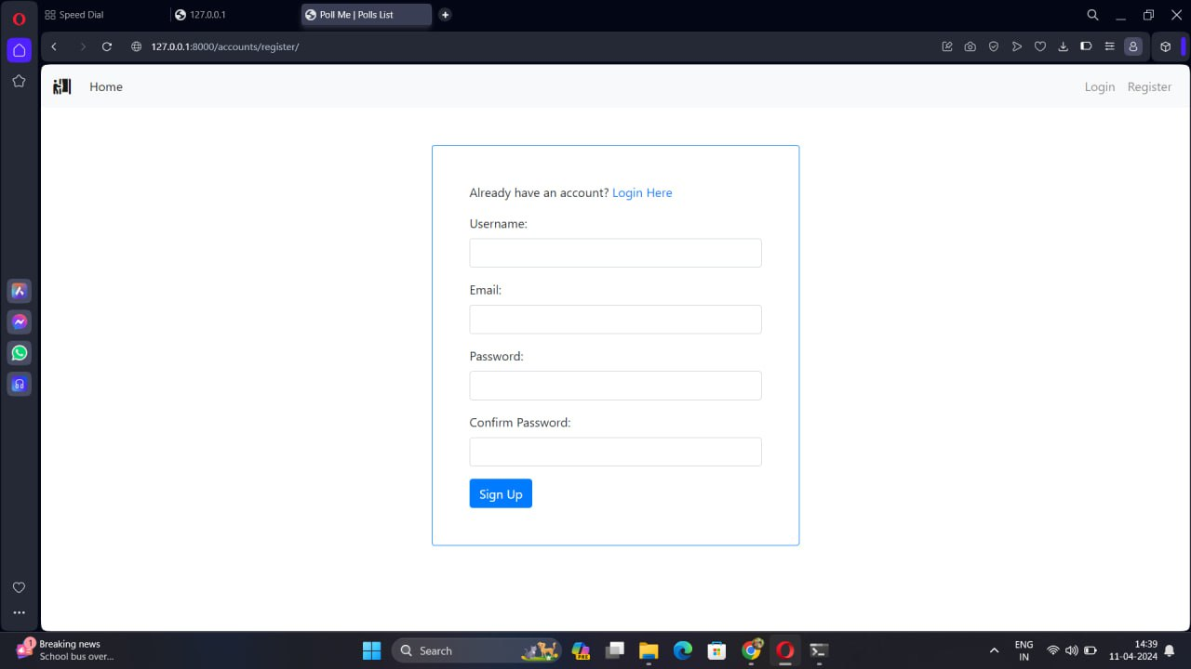
Voting Web Application Using Django Framework

Slide 11
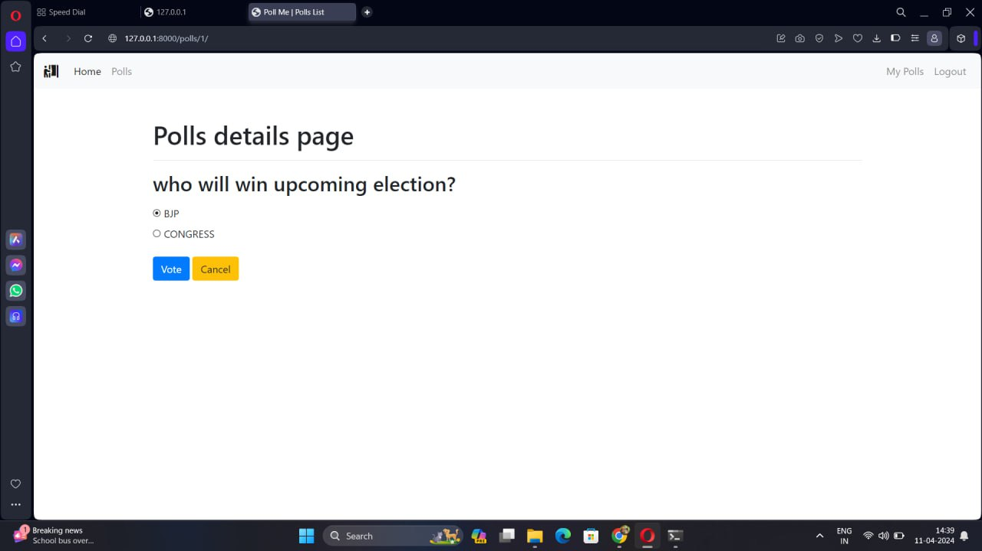
Voting Web Application Using Django Framework

Slide 12

Voting Web Application Using Django Framework
Conclusion
In summary, developing a voting web application using the Django framework offers a streamlined and efficient approach to creating a secure, interactive, and user-friendly platform.
By leveraging Django's robust features for user authentication, data management, and administrative control, coupled with responsive design and security measures, the application can provide a seamless voting experience for users while ensuring the integrity and confidentiality of the voting process.
With its scalability, flexibility, and accessibility, a Django-based voting web application stands as a versatile solution for facilitating democratic participation and engagement in various settings.
Notes:
12

Slide 13
Voting Web Application Using Django Framework
Thank you!
Notes:
13

